Slide 1
COMP2084 – Server Side Scripting with ASP.NET
Week 3: Views

Slide 2
THE PURPOSE OF VIEWS
The view is responsible for providing the user interface (UI) to the user.
After the controller has executed the appropriate logic for the requested URL, it delegates the display to the view.
Unlike file-based web frameworks, such as ASP.NET Web Forms and PHP, views are not themselves directly accessible.
You can’t point your browser to a view and have it render.
Instead, a view is always rendered by a controller, which provides the data the view will render.
In some simple cases, the view needs little or no information from the controller.
More often, the controller needs to provide some information to the view, so it passes a data transfer object called a model.
The view transforms that model into a format ready to be presented to the user.
In ASP.NET MVC, the view accomplishes this by examining a model object handed off to it by the controller and transforming the contents of that to HTML.

Slide 3
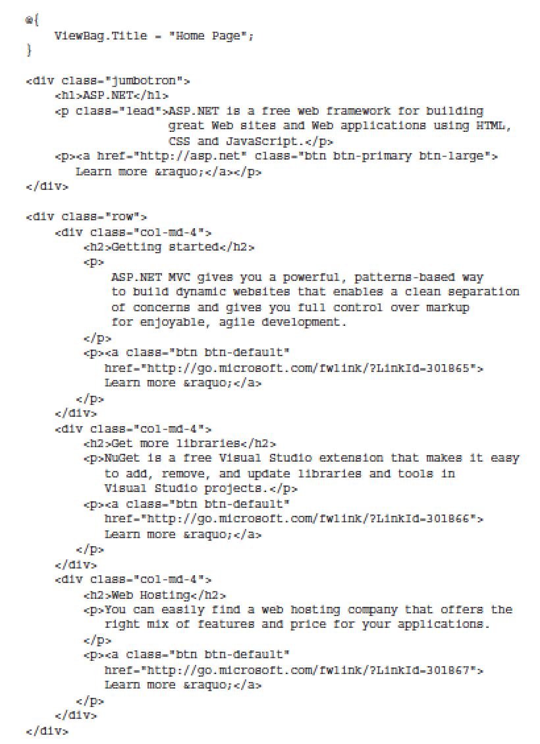
VIEW BASICS
The easiest way to get the hang of what views do is to take a look at the sample views that are created in a new ASP.NET MVC application.
Let’s start by taking a look at the simplest case: a view that doesn’t need any information from the controller.
Aside from the tiny bit of code at the top that sets the page title, this is all just standard HTML.

Slide 4
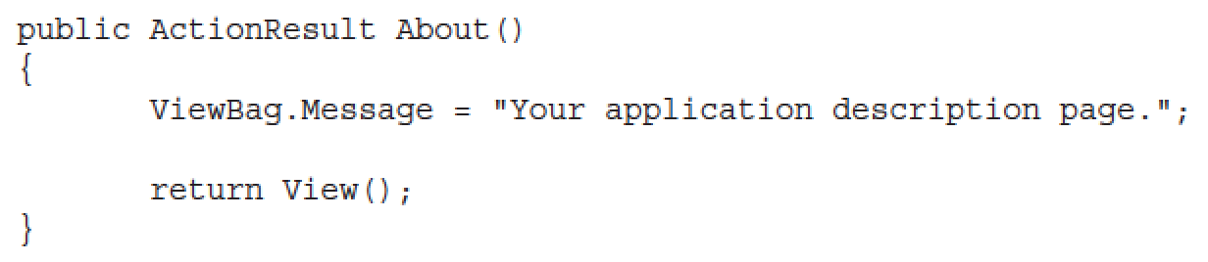
VIEW BASICS (cont’d)
Views offer a templating engine, so let’s take advantage of that by passing a tiny bit of data from the controller to a view.
The easiest way to do that is using a ViewBag.
ViewBag has limitations, but it can be useful if you’re just passing a little data to the view.
Take a look at the About action method in HomeController.cs
This is nearly identical to the Index method you looked at earlier, but notice that the controller sets the ViewBag.Message property to a string before calling return View().

Slide 5
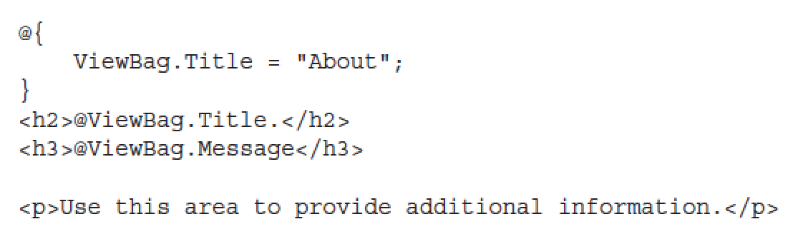
VIEW BASICS (cont’d)
Now take a look at the corresponding view:
The @ character before both ViewBag values is the most important part of Razor syntax you’ll learn in this chapter: It tells the Razor view engine that the following characters are code, not HTML text.
This view is really simple—it sets the page title to ViewBag.Title, and then displays both the ViewBag.Title and ViewBag.Message values in header tags.
The @ character before both ViewBag values is the most important part of Razor syntax you’ll learn in this chapter: It tells the Razor view engine that the following characters are code, not HTML text.

Slide 6
UNDERSTANDING VIEW CONVENTIONS

Slide 7
UNDERSTANDING VIEW CONVENTIONS
In the previous section, you looked at some examples that illustrate how to use views to render HTML.
In this section, you learn how ASP.NET MVC finds the correct view to render and how you can override this to specify a particular view for a controller action.
The controller actions you’ve looked at so far in this chapter have just called return View() to render the view—they haven’t had to specify the view’s filename.
That’s because they take advantage of some implicit conventions in the ASP.NET MVC Framework, which define the view selection logic.

Slide 8
UNDERSTANDING VIEW CONVENTIONS (cont’d)
When you create a new project template, you’ll notice that the project contains a Views directory structured in a very specific manner.
Each controller folder contains a view file for each action method, and the file is named the same as the action method.
This provides the basis for how views are associated to an action method.
The view selection logic looks for a view with the same name as the action within the /Views/ControllerName directory (the controller name without the Controller suffix in this case).

Slide 9
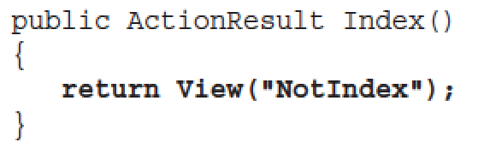
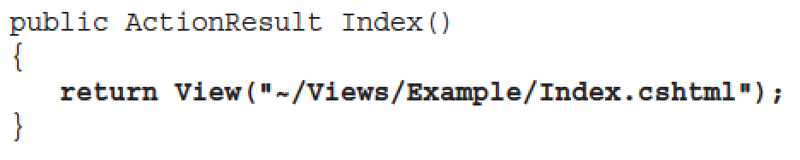
UNDERSTANDING VIEW CONVENTIONS (cont’d)
As with most things in ASP.NET MVC, you can override this convention.
Suppose that you want the Index action to render a different view, you could supply a different view name, as follows:
In this case, it will still look in the /Views/Home directory, but choose NotIndex.cshtml as the view.
In some situations, you might even want to specify a view in a completely different directory structure.
You can use the tilde syntax to provide the full path to the view, as follows:

Slide 10
STRONGLY TYPED VIEWS

Slide 11
STRONGLY TYPED VIEWS
So far in this lesson, we’ve just looked at very simple examples that pass a little bit of data to the view via the ViewBag.
Although using the ViewBag is easy for simple cases, it becomes unwieldy when working with real data.
That’s where strongly typed views come in—we’ll look at those now.
We’ll start with an example showing how ViewBag falls short—don’t worry about typing this part; it’s just for illustration.

Slide 12
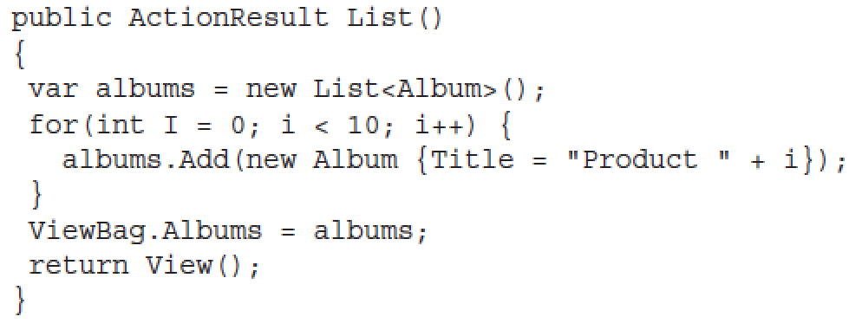
How ViewBag Falls Short
Suppose you need to write a view that displays a list of Album instances.
One possible approach is to simply add the albums to the ViewBag and iterate over them from within the view.
For example, the code in your controller action might look like this:

Slide 13
How ViewBag Falls Short (cont’d)
In your view, you can then iterate and display the products, as follows:
Notice that you needed to cast ViewBag.Albums (which is dynamic) to an IEnumerable<Album> before enumerating it.

Slide 14
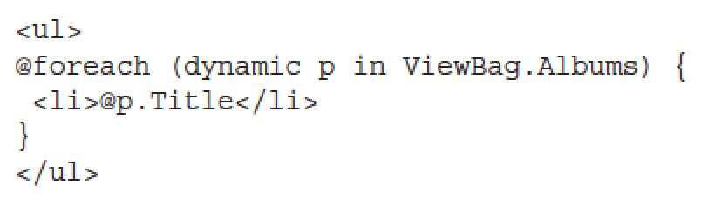
How ViewBag Falls Short (cont’d)
You could have also used the dynamic keyword here to clean the view code up, but you would have lost the benefit of IntelliSense when accessing the properties of each Album object.
It would be nice to have the clean syntax afforded by the dynamic example without losing the benefits of strong typing and compile-time checking of things, such as correctly typed property and method names.
This is where strongly typed views come in: strongly typed views allow you to set a model type for a view.

Slide 15
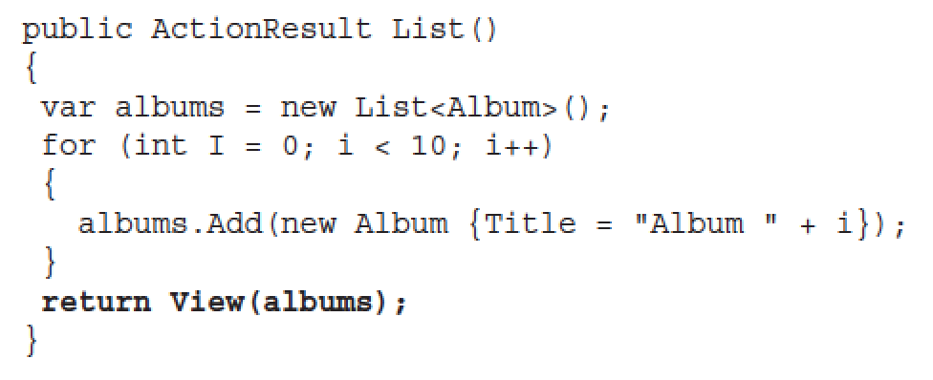
How ViewBag Falls Short (cont’d)
Strong Typed Views allow you to pass a model object from the controller to the view that’s strongly typed on both ends, so you get the benefit of IntelliSense, compiler checking, and so on.
In the Controller method, you can specify the model via an overload of the View method whereby you pass in the model instance:

Slide 16
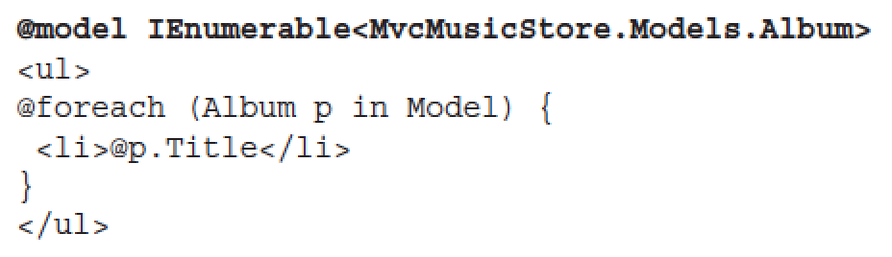
How ViewBag Falls Short (cont’d)
The next step is to indicate to the view what type of model is using the @model declaration.
Note that you might need to supply the fully qualified type name (namespace plus type name) of the model type.

Slide 17
How ViewBag Falls Short (cont’d)
To avoid needing to specify a fully qualified type name for the model, you can make use of the @using declaration.

Slide 18
VIEW MODELS

Slide 19
VIEW MODELS
Often a view needs to display a variety of data that doesn’t map directly to a domain model.
For example, you might have a view meant to display details about an individual product. But this same view also displays other information that’s ancillary to the product, such as the name of the currently logged-in user, whether that user is allowed to edit the product or not, and so on.
One easy approach to displaying extra data that isn’t a part of your view’s main model is to simply stick that data in the ViewBag.
This is especially useful when you have a clearly defined model and some additional reference data.

Slide 20
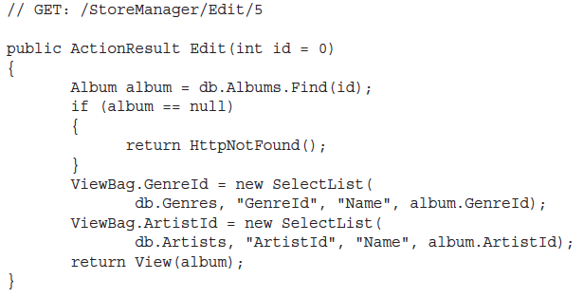
VIEW MODELS (cont’d)
A common application of this technique is using the ViewBag to provide form options for a dropdown.
For example, the Album Edit view for the MVC Music Store needs to populate dropdowns for Genres and Albums in our system, but those lists don’t fit in the Album model.
To handle this without polluting our Album model with extraneous information, we can pop the Genre and Album information into the ViewBag:

Slide 21
VIEW MODELS (cont’d)
The previous example certainly gets the job done and provides a flexible approach to displaying data within a view.
But it’s not something you’ll want to use very often.
You’ll generally want to stick with strongly typed model objects for the reasons we’ve mentioned earlier — you want to control the data that flows into your view and have it all be strongly typed so your view authors can take advantage of IntelliSense.
One recommended approach is to write a custom view model class.
You can think of a view model as a model that exists just to supply information for a view.
Note that the term view model here is different from the concept of view model within the Model View ViewModel (MVVM) pattern.
That’s why we use the term view specific model when I discuss view models.

Slide 22
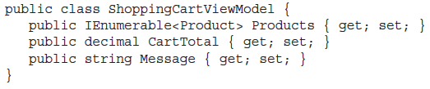
VIEW MODELS (cont’d)
For example, if you had a shopping cart summary page that needed to display a list of products, the total cost for the cart, and a message to the user, you could create the ShoppingCartViewModel class, shown as follows:

Slide 23
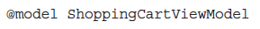
VIEW MODELS (cont’d)
Now you can make a view strongly typed to this model, using the following @model directive:
This gives you the benefits of a strongly typed view (including type checking, IntelliSense, and freedom from having to cast untyped ViewDataDictionary objects) without requiring any changes to the Model classes.

Slide 24
ADDING A VIEW

Slide 25
ADDING A VIEW
In the “View Basics” and “View Conventions” sections you learned how a controller specifies a view.
But how does that view get created in the first place? You could certainly create a file by hand and add it to your Views directory, but the ASP.NET MVC tooling for Visual Studio makes adding a view using the Add View dialog very easy.

Slide 26
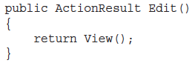
ADDING A VIEW (cont’d)
The easiest way to display the Add View dialog is to right-click in an action method.
You can use any action method you’d like; for this example you can just add a new action method named Edit and then create a view for that action using the Add View dialog.
Begin by adding an Edit action method to the HomeController in an MVC 5 application that contains the following code:

Slide 27
ADDING A VIEW (cont’d)
Next, launch the Add View dialog by right-clicking an action method and selecting Add View. This brings up the Add View dialog:

Slide 28
ADDING A VIEW (cont’d)
The following list describes each menu item in detail:
View name: When launching this dialog from the context of an action method, the view name is prepopulated using the name of the action method. Naturally, the view name is required.
Template: After you select a type, you can also choose a scaffold template. These templates use the Visual Studio templating system to generate a view based on the model type selected.

Slide 29
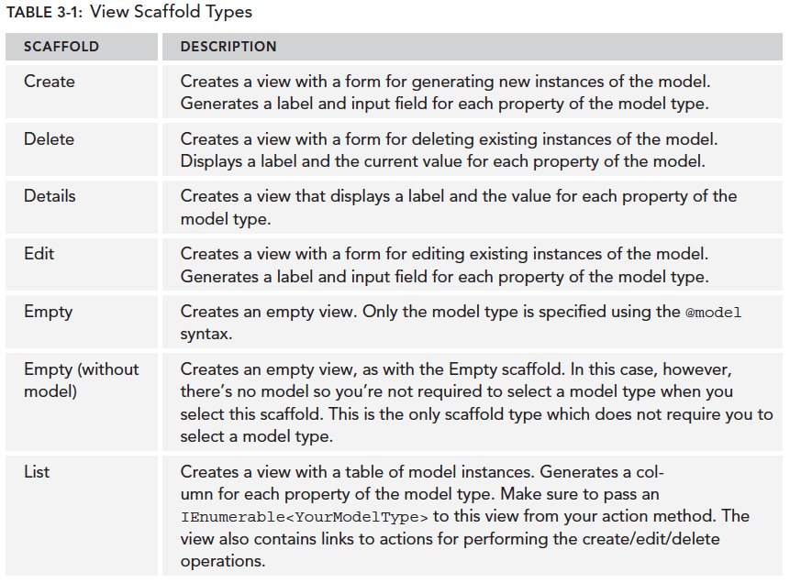
ADDING A VIEW (cont’d)

Slide 30
ADDING A VIEW (cont’d)
Reference script libraries: This option indicates whether the view you are creating should include references to a set of JavaScript files if it makes sense for the view. By default, the _Layout.cshtml file references the main jQuery library, but doesn’t reference the jQuery Validation library or the Unobtrusive jQuery Validation library. When creating a view that will contain a data entry form, such as an Edit view or a Create view, selecting the Reference script libraries option adds a script reference to the jqueryval bundle. These libraries are necessary for implementing client-side validation. In all other cases, this checkbox is completely ignored.
Create as a partial view: Selecting this option indicates that the view you will create is not a full view, thus the Layout option is disabled. The resulting partial view looks much like a regular view, except you’ll have no <html> tag or <head> tag at the top of the view.
Use a layout page: This option determines whether or not the view you are creating references a layout or is a fully self-contained view. Specifying a layout is not necessary if you choose to use the default layout because the layout is already specified in the _ViewStart.cshtml file. However, you can use this option to override the default Layout file.

Slide 31
THE RAZOR VIEW ENGINE

Slide 32
What Is Razor?
Razor provides a streamlined syntax for expressing views that minimizes the amount of syntax and extra characters.
It effectively gets out of your way and puts as little syntax as possible between you and your view markup.
Enhanced with the first-rate IntelliSense support for Razor in Visual Studio.

Slide 33
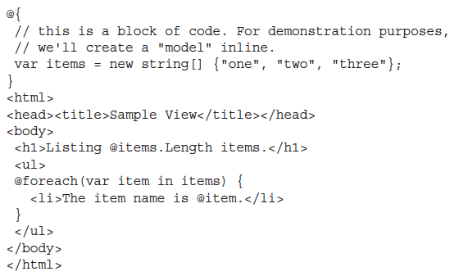
What Is Razor? (cont’d)
The following example demonstrates a simple Razor view that contains a bit of view logic:

Slide 34
Code Expressions
The key transition character in Razor is the “at” sign (@).
This single character is used to transition from markup to code and sometimes also to transition back.
The two basic types of transitions are code expressions and code blocks.
Expressions are evaluated and written to the response.
For example, in the following snippet:
notice that the expression @items.length is evaluated as an implicit code expression and the result, is displayed in the output.
One thing to notice, though, is that we didn’t need to demarcate the end of the code expression.

Slide 35
Code Expressions (cont’d)
In contrast, with a Web Forms view, which supports only explicit code expressions, this would look like:
Razor is smart enough to know that the space character after the expression is not a valid identifier, so it transitions smoothly back into markup.

Slide 36
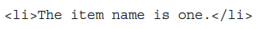
Code Expressions (cont’d)
Notice that in the unordered list, the character after the @item code expression is a valid code character.
How does Razor know that the dot after the expression isn’t meant to start referencing a property or method of the current expression?
Well, Razor peeks at the next character and sees an angle bracket, which isn’t a valid identifier, and transitions back into markup mode.
Thus the first list item renders out:

Slide 37
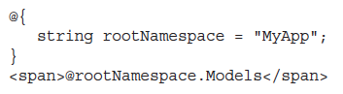
Code Expressions (cont’d)
This ability for Razor to automatically transition back from code to markup is one of its big appeals and is the secret sauce in keeping the syntax compact and clean.
However, this feature might make some of you worry that ambiguities can occur.
For example, what if you had the following Razor snippet?
In this particular case, the hoped-for output was:

Slide 38
Code Expressions (cont’d)
The previous example generates an error that there is no Models property of string.
In this admittedly edge case, Razor couldn’t understand your intent and thought that @rootNamespace.Models was the code expression.
Fortunately, Razor also supports explicit code expressions by wrapping them in parentheses:
This tells Razor that .Models is literal text and not part of the code expression.

Slide 39
Code Expressions (cont’d)
While we’re on the topic of code expressions, we should also look at the case where you intend to show an e-mail address.
For example, consider the following e-mail address:
At first glance, this seems like it would cause an error because @megacorp.com looks like a valid code expression where we’re trying to print out the com property of the megacorp variable.
Fortunately, Razor is smart enough to recognize the general pattern of an e-mail address and will leave this expression alone.

Slide 40
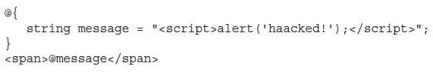
HTML Encoding
Given that many cases exist where a view is used to display user input, such as a blog post comment or a product review, the potential always exists for cross-site script injection attacks (also known as XSS).
The good news is that Razor expressions are automatically HTML encoded.
This code does not result in an alert box popping up but instead renders the encoded HTML:

Slide 41
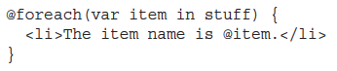
Code Blocks
In addition to code expressions, Razor also supports code blocks within a view.
Going back to the sample view, you might remember seeing a foreach statement:
This block of code iterates over an array and displays a list item element for each item in the array.
What’s interesting about this statement is how the foreach statement automatically transitions to markup with the open <li> tag.

Slide 42
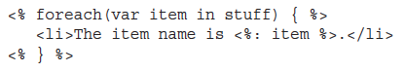
Code Blocks (cont’d)
Sometimes, when people see code block above, they assume that the transition occurs because of the new line character, but the following valid code snippet shows that’s not the case:
Because Razor understands the structure of HTML markup, it also transitions automatically back to code when the <li> tag is closed.
Thus we didn’t need to demarcate the closing curly brace at all.
Contrast this to the Web Forms view engine equivalent snippet, where the transitions between code and markup have to be explicitly denoted:

Slide 43
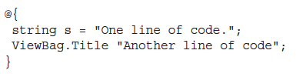
Code Blocks (cont’d)
Blocks of code (sometimes referred to as a code block) require curly braces to delimit the block of code in addition to an @ sign.
One example of this is in a multi-line code block:
Another example of this is when calling methods that don’t return a value (that is, the return type is void):

Slide 44
Razor Syntax Samples

Slide 45
Razor Syntax Samples
This section provides samples that illustrate Razor syntax for a number of common use cases.

Slide 46
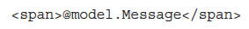
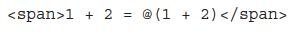
Razor Syntax Samples (cont’d)
Implicit Code Expression
As described previously, code expressions are evaluated and written to the response.
This is typically how you display a value in a view:
Explicit Code Expression
Code expressions are evaluated and written to the response.
This is typically how you display a value in a view:

Slide 47
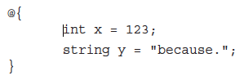
Razor Syntax Samples (cont’d)
Unencoded Code Expression
In some cases, you need to explicitly render some value that should not be HTML encoded.
You can use the Html.Raw method to ensure that the value is not encoded.
Code Block
Unlike code expressions, which are evaluated and outputted to the response, blocks of code are simply sections of code that are executed.
They are useful for declaring variables that you might need to use later.

Slide 48
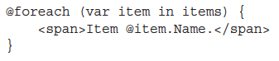
Razor Syntax Samples (cont’d)
Combining Text and Markup
This example shows what intermixing text and markup looks like using Razor.

Slide 49
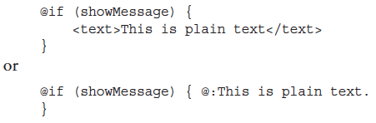
Razor Syntax Samples (cont’d)
Combining Text and Markup
Razor looks for the beginning of a tag to determine when to transition from code to markup.
However, sometimes you want to output plain text immediately after a code block.
For example, the following sample displays some plain text within a conditional block.

Slide 50
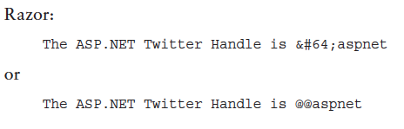
Razor Syntax Samples (cont’d)
Escaping the Code Delimiter
As you saw earlier in this chapter, you can display @ by encoding it using @@.
Alternatively, you always have the option to use HTML encoding:

Slide 51
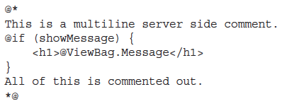
Razor Syntax Samples (cont’d)
Server-Side Comment
Razor includes a nice syntax for commenting out a block of markup and code.

Slide 52
Razor Syntax Samples (cont’d)
Calling a Generic Method
Calling a generic method is really no different from calling an explicit code expression.
Even so, many folks get tripped up when trying to call a generic method.
The confusion comes from the fact that the code to call a generic method includes angle brackets.
And as you’ve learned, angle brackets cause Razor to transition back to markup unless you wrap the whole expression in parentheses.

Slide 53
Layouts
Layouts in Razor help maintain a consistent look and feel across multiple views in your application.
If you’re familiar with Web Forms, layouts serve the same purpose as master pages, but offer both a simpler syntax and greater flexibility.
You can use a layout to define a common template for your site (or just part of it).
This template contains one or more placeholders that the other views in your application provide content for.
In some ways, it’s like an abstract base class for your views.

Slide 54
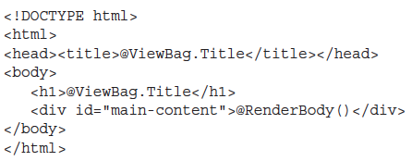
Layouts (cont’d)
Let’s look at a very simple layout; we’ll creatively call it SiteLayout.cshtml:

Slide 55
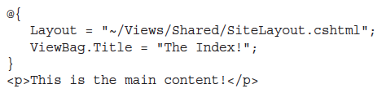
Layouts (cont’d)
It looks like a standard Razor view, but note that there’s a call to @RenderBody in the view.
This is a placeholder that marks the location where views using this layout will have their main content rendered.
Multiple Razor views may now take advantage of this layout to enforce a consistent look and feel.
Let’s look at an example that uses this layout, Index.cshtml:

Slide 56
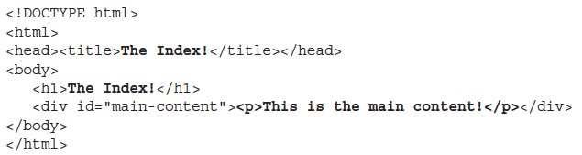
Layouts (cont’d)
The view above specifies its layout via the Layout property.
When this view is rendered, the HTML contents in this view are placed within the DIV element, main-content of SiteLayout.cshtml, resulting in the following combined HTML markup:

Slide 57
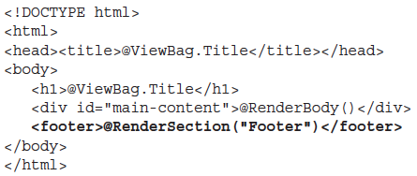
Layouts (cont’d)
A layout may have multiple sections.
For example, add a footer section to the previous layout, SiteLayout.cshtml:

Slide 58
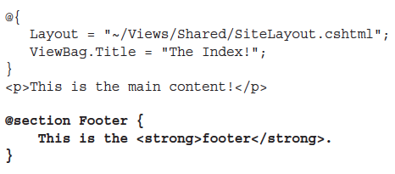
Layouts (cont’d)
Running the previous view again without any changes will throw an exception stating that a section named Footer was not defined.
By default, a view must supply content for every section defined in the layout.
Here’s the updated view:

Slide 59
Layouts (cont’d)
The @section syntax specifies the contents for a section defined in the layout.
Earlier, it was pointed out that, by default, a view must supply content for every defined section.
So what happens when you want to add a new section to a layout? Will that break every view?
Fortunately, the RenderSection method has an overload that allows you to specify that the section is not required.
To mark the Footer section as optional you can pass in false for the required parameter:

Slide 60
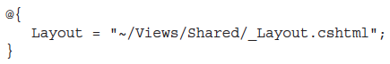
ViewStart
In the preceding examples, each view specified its layout page using the Layout property.
For a group of views that all use the same layout, this can get a bit redundant and harder to maintain.
You can use the _ViewStart.cshtml page to remove this redundancy.
The code within this file is executed before the code in any view placed in the same directory.
This file is also recursively applied to any view within a subdirectory.
When you create a default ASP.NET MVC project, you’ll notice a _ViewStart.cshtml file is already in the Views directory.
It specifies a default layout:

Slide 61
SPECIFYING A PARTIAL VIEW

Slide 62
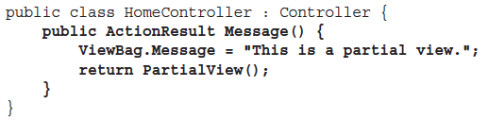
SPECIFYING A PARTIAL VIEW
In addition to returning a view, an action method can also return a partial view in the form of a PartialViewResult via the PartialView method.
Here’s an example:
In this case, the view named Message.cshtml is rendered; however, if the layout is specified by a _ViewStart.cshtml page (and not directly within the view), the layout is not rendered.

Slide 63
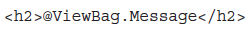
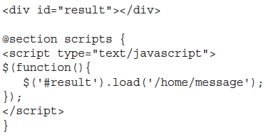
SPECIFYING A PARTIAL VIEW (cont’d)
The partial view above itself looks much like a normal view, except it doesn’t specify a layout:
This is useful in partial update scenarios using Ajax.
The following shows a simple example using jQuery to load the contents of a partial view into the current view using an Ajax call:

Slide 64
SPECIFYING A PARTIAL VIEW (cont’d)
The preceding code uses the jQuery load method to make an Ajax request to the Message action and updates the DIV with the id result with the result of that request.

Slide 65
SUMMARY
View engines have a specific, constrained purpose.
They exist to take data passed to them from the controller and generate formatted output, usually HTML.
Other than those simple responsibilities, or concerns, as the developer you are empowered to achieve the goals of your view in any way that makes you happy.
The Razor view engine’s terse and simple syntax makes writing rich and secure pages easy, regardless of whether the pages are simple or complex.

